Slide 1
Operational Due Diligence-Key to M&A Success
Igor Zax, CFA, Sloan Fellow (LBS)
Managing Director- Tenzor Ltd

Slide 2
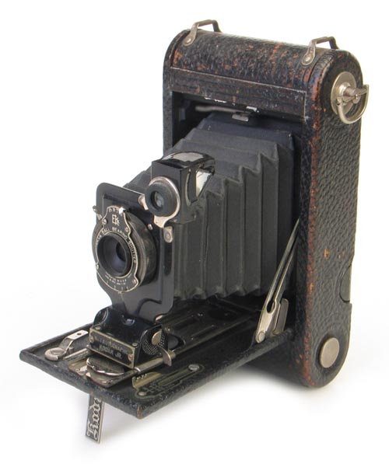
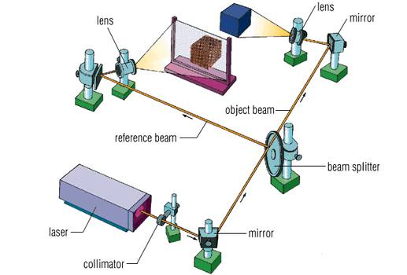
What is operational due diligence?
Just one side?
ODD-Multi Dimensional Picture
Legal
Accounting
Target
We need not only answer “what” but “why” and “what does this mean?”

Slide 3
Operational Due Diligence-core questions to answer
Re-construct the link between the numbers and physical process
Do not limit your conversation to finance people- they talk about numbers, not the business
Speak to sales, procurement, manufacturing- and reconcile what you hear to what you see in the numbers
Understand external environment- suppliers, customers, distributors- they may tell you a lot of things you would not hear from the company
Visit the warehouse and manufacturing and ask few simple questions

Slide 4
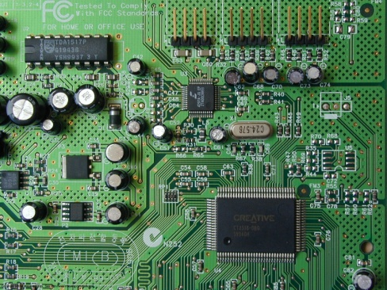
Practical Example- What Can you find in a warehouse
PCB
PCBA
What Do you see in Warehouse?
Two similar boards (one of which is PCB and one is assembled) are on the warehouse shelf
What do you see in Accounts?
Working Capital problems
What do you see in Manufacturing:
Delays, quality issues
What do you see in Customer Service
Quality Issues

Slide 5
Question to ask – Why? And Is there a link?
The company is buying printed circuit board from a small supplier with advance payment
They have no way to properly do QC before assembly
They send the board for assembly to another far away provider
When they finally got the board back, they find not all of them pass testing. Complex process to find out whose fault (from the two suppliers) it is.
What we discovered – WRONG SUPPLY CHAIN causing the problem

Slide 6
Industry structure and Supply Chain
Global industry structures changed massively
Platform companies "Produces nowhere but sells everywhere... know where the clients are and what they want and where the producers are. Platform companies then simply organise the ordering by the clients and the delivery by the producers (and the placing of their logo on the product just before delivery).“- GaveKal
Integrated and collaborative supply chains.
Contract manufacturing, outsourcing, muli-tier distribution
Changed structures are often ignored by analysts

Slide 7
Supply Chain- Distribution of Risk and Reward
Component Manufacturers
Component Distributors
Contract Manufacturers
OEM
Customers!
Distributors
VARs
Understanding the supply chain is core to determining the future of the company.
How is wealth and risk distributed?
What is outsourced to whom? Who does financing- is the company a bank? Should it be?
What is overall health of the chain, distribution of rewards and risks at particular layer or just company specific issues?
Do company numbers represent “steady state” or a time specific state of the chain
Who can “shortcut” the chain and what would be consequences?

Slide 8
Supply Chain-Value Chain Implications
Split of value within value chain may change, and current split may be caused by a number of reasons
Creating a short term spike in value (that would only last for the time for the rest of the chain to adopt) may boost the numbers, but eventually may be devastating for the business
Longer chains have more complex dynamics – analysing multi-tier chain with the tools designed for a single tier (i.e. Suppliers and Customers) lead to wrong results

Slide 9
Supply Chain-Working Capital Implications
One can move working capital and risk up and down the chain at a price.
You can almost always add an intermediary that improve any component of your working capital (A/R, Inventory, A/P) at a price (for example pay you at 30 days and collect from their customer’s at 90 days).
There are component trade offs (inventory against A/R or A/P).
Analysing working capital without understanding of supply chain structure is confusing

Slide 10
Working Capital- Good Starting Point for ODD
Most of the problems of companies manifest themselves in working capital (A/R, Inventories, A/P)
Aged debtor list and its analyses vs. sales
Are receivables real?
Is ageing real ?
Why payments are late – disputes vs. credit?
Are sales real?
What happened prior to sale?
Sale is converting inventory to A/R showing a profit. Did it
Push the problem next level?
Chanel overstocking?
Produce uncollectable A/R
Is there actual end user demand?

Slide 11
Working Capital Analyses –cont.
Analysing late payments allows to uncover issues with quality, logistics, systems, etc. –credit management is the best source of information about the company issues
A/P
Short terms – why terms are not offered?
May be wrong supplier, no insurance cover, bad history?
Long terms –are these sustainable?
Overdues- would these be tolerated?
Key question – are suppliers still supplying or they already or about to stop?
May be significant cash outflow post acquisition.

Slide 12
Working Capital Analyses- cont
Inventory
Clear distinction between finished goods, components and work in progress
Obsolescence
Components for wrong models? They may be perfectly good but perfectly useless
Is there a process for managing inventories?
Overreliance on ratios- these are just averages
“Good” DSO may be a mixture of prepayments and massive overdue
“Good” DIO may be a large pile of useless stuff and a massive shortage of needed inventories
“Good” DPO may be a mixture of pre-paid suppliers and the ones who already stop supply and looking for legal action

Slide 13
CAPEX/ Development Costs
EBITDA focus creates a strong incentive to under invest
Company can run on close to zero CAPEX and even maintenance for a while – but this would mean massive cost in the future
Cutting R&D improves short term profitability but negatively affects future cash flows.
Cutting people improves profitability but in many business this is the main asset.
Particularly relevant for industry buyers- often overestimating own ability to develop/support

Slide 14
Processes
Assets are not enough –there should be a process for business to run
If one thinks of outsourcing (either manufacturing or service) one needs to have a n efficient process in the first place
Efficient and well documented process can be “portable”- i.e. Moved to different location etc. If the “process” is based on a “fire fighting” skills it is not only inefficient, but not “portable”
One needs to understand what they are buying – “whole business” or its part (for example sales team or R&D capability)
If part of the business is not needed, what would it cost to liquidate and would this adversely affect the “desired” part.

Slide 15
Value is in the eyes of the beholder
Type of due diligence would depend on type of the buyer
Financial investor needs to look if the business is going to perform in its current form- this becomes focus of the due diligence
Strategic (industrial) investor looks if the business would fit/add value to it – this changing the operational due diligence process
And type of the seller
Understanding seller motivation and way of operating
Spin offs- are these truly autonomous? And how they can fit? What do their numbers reflect in reality?
PE –the buyer is dealing with professional seller
Emerging markets – can company operate being managed by investor that have to comply with Bribery Act (UK), FCPA (US) or other regulatory or ethical requirements?

Slide 16
Why Vertical Integration?
Recent years show a global trend to “platformisation”
This was driven by lower transaction costs, supply chain coordination and general low risk environment
This is changing now, as risk is again high on the agenda, and transaction costs are up
Deals start coming small and very large
Cost of acquiring supply chain partner may be lower than switching cost
Resolving of concentration problem- getting away from excessive dependencies.
A lot of supply chain optimisation techniques designed for a “risk free” world
In a risky world it is cheaper to have a solution within a firm- the very reason firms exist (Richard Coase, Nobel price in economics 1991)

Slide 17
Vertical Integration- Working Capital Implications
Buying a week player up the chain- moving from concentrated non- financeable receivables book to diversified
Merged company can finance receivables- target on its own find it difficult because of operational risks.
Inventories – can be managed down on elimination of bullwhip effect and reduction of safety stock to cover supply risks
Payables. If target facing withdraw of lines from suppliers or credit insurance, restoring of these can provide immediate working capital boost.
Conclusion: Working Capital may change tremendously in a successful acquisition, providing cash boost instead to cash drain to acquirer. Due diligence needs to find out if this is a feasible option

Slide 18
Conclusions
Beware of supply chain structure
Working Capital is one of the best places to start due-diligence
Focus due diligence on what do you want to do with the company
Understand the seller motivation- this would help to see the key areas of focus.

Slide 19
Thank You and Good Luck!
Igor Zax, CFA, Sloan Fellow (London Business School)
Managing Director, Tenzor Ltd. (London)
Tel: +447775708426
E-Mail: igor.zax@tenzor.co.uk
Web site: www.tenzor.co.uk

